Slide 1
Elliptic Curve Cryptography
Other Equation for Elliptic Curves

Slide 2
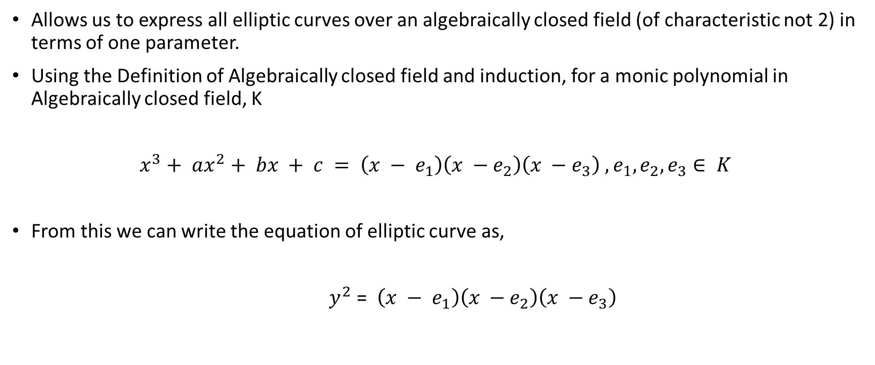
Legendre Equation
Allows us to express all elliptic curves over an algebraically closed field (of characteristic not 2) in terms of one parameter.
Using the Definition of Algebraically closed field and induction, for a monic polynomial in Algebraically closed field, K
$x^{3}+ ax^{2}+ bx + c = \left(x − e_{1}\right)\left(x −e_{2}\right)\left(x −e_{3}\right)$ $,e_{1},e_{2},e_{3}∈ K$
From this we can write the equation of elliptic curve as,
$y^{2}$ = $\left(x − e_{1}\right)\left(x −e_{2}\right)\left(x −e_{3}\right)$

Slide 3
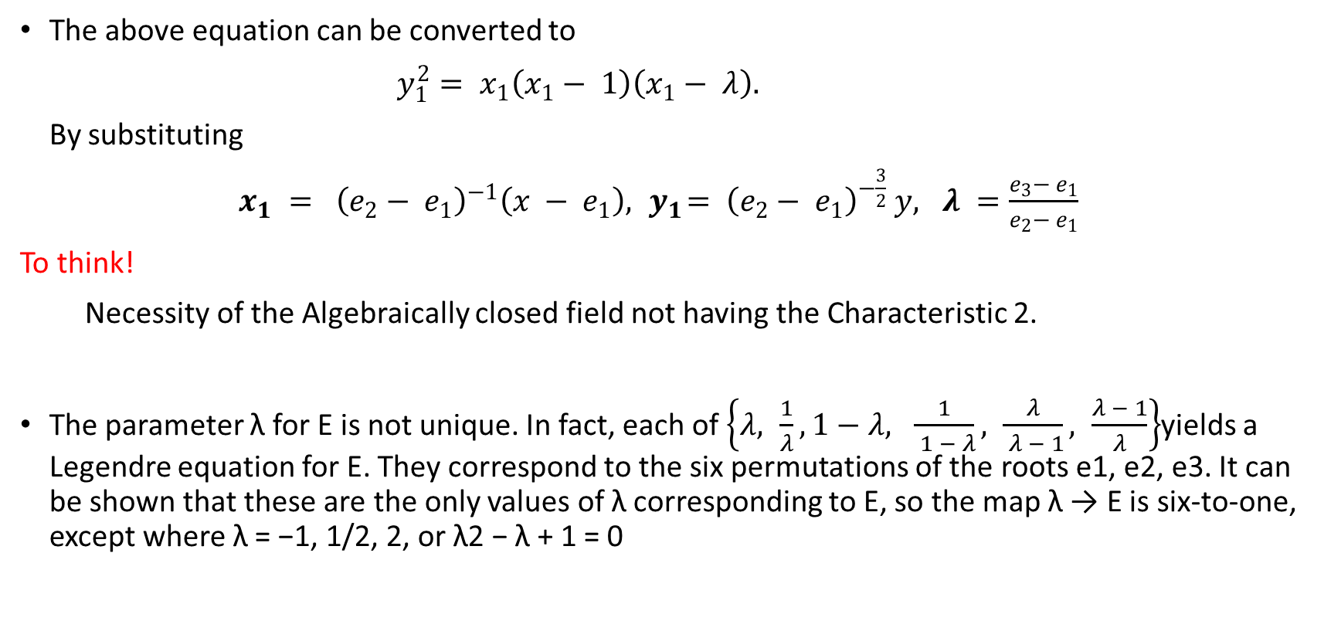
Contd.
The above equation can be converted to
$y_{1}^{2}= x_{1}\left(x_{1}− 1\right)\left(x_{1}− λ\right).$
By substituting
$x_{1} = {\left(e_{2}− e_{1}\right)}^{−1}\left(x − e_{1}\right), { y}_{1}= {\left(e_{2}− e_{1}\right)}^{−\frac{3}{2}} y, λ =\frac{e_{3}− e_{1}}{e_{2}− e_{1}}$
To think!
Necessity of the Algebraically closed field not having the Characteristic 2.
The parameter λ for E is not unique. In fact, each of $\left\{λ, \frac{1}{λ}, 1−λ, \frac{1}{ 1 − λ}, \frac{λ}{ λ − 1}, \frac{λ − 1}{λ}\right\}$yields a Legendre equation for E. They correspond to the six permutations of the roots e1, e2, e3. It can be shown that these are the only values of λ corresponding to E, so the map λ → E is six-to-one, except where λ = −1, 1/2, 2, or λ2 − λ + 1 = 0

Slide 4
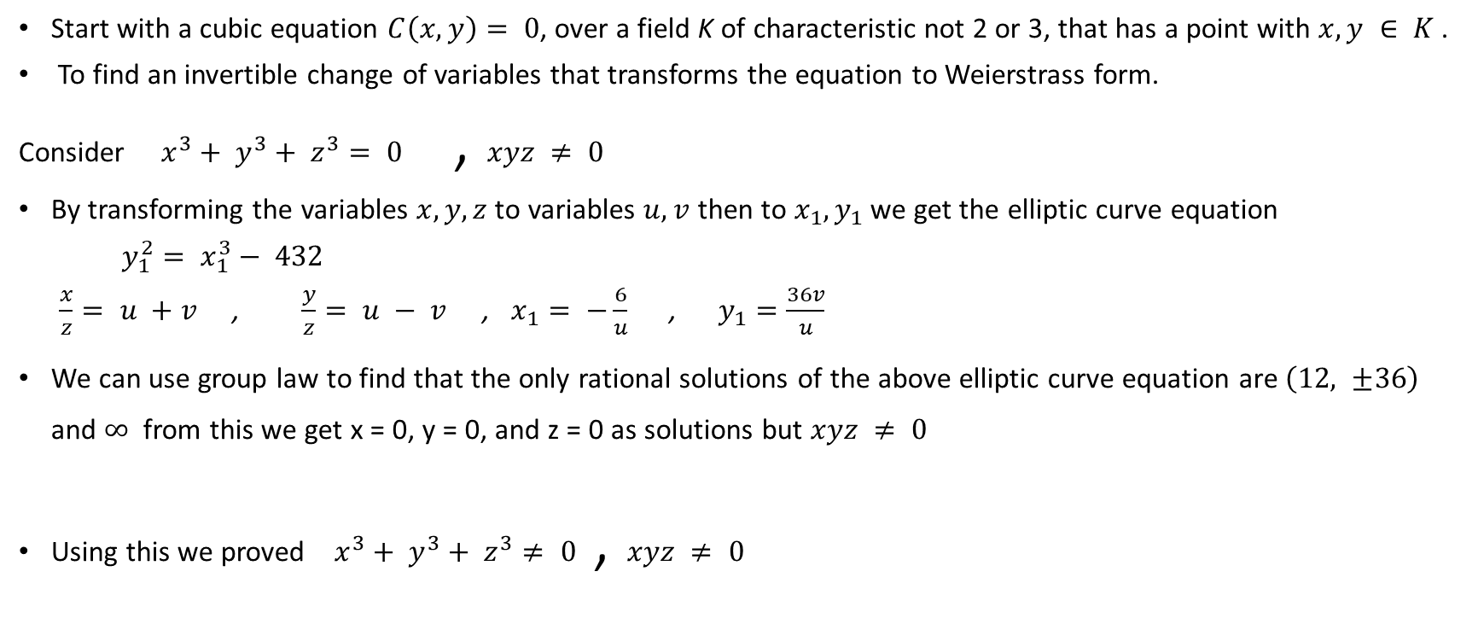
Cubic Equation
Start with a cubic equation $C\left(x, y\right)= 0$, over a field K of characteristic not 2 or 3, that has a point with $x, y ∈ K$.
To find an invertible change of variables that transforms the equation to Weierstrass form.
Consider $x^{3}+ y^{3}+ z^{3}= 0$ , $xyz ≠ 0$
By transforming the variables $x, y, z$to variables $u, v$ then to $x_{1}, y_{1}$ we get the elliptic curve equation
$y_{1}^{2}= x_{1}^{3}− 432$
$\frac{x}{z}= u +v$ , $\frac{y}{z}= u − v$ , $x_{1}= −\frac{6}{u}$ , $y_{1}=\frac{36v}{u}$
We can use group law to find that the only rational solutions of the above elliptic curve equation are $\left(12, ±36\right)$ and $∞$ from this we get x = 0, y = 0, and z = 0 as solutions but $xyz ≠ 0$
Using this we proved $x^{3}+ y^{3}+ z^{3}≠ 0$ , $xyz ≠ 0$

Slide 5
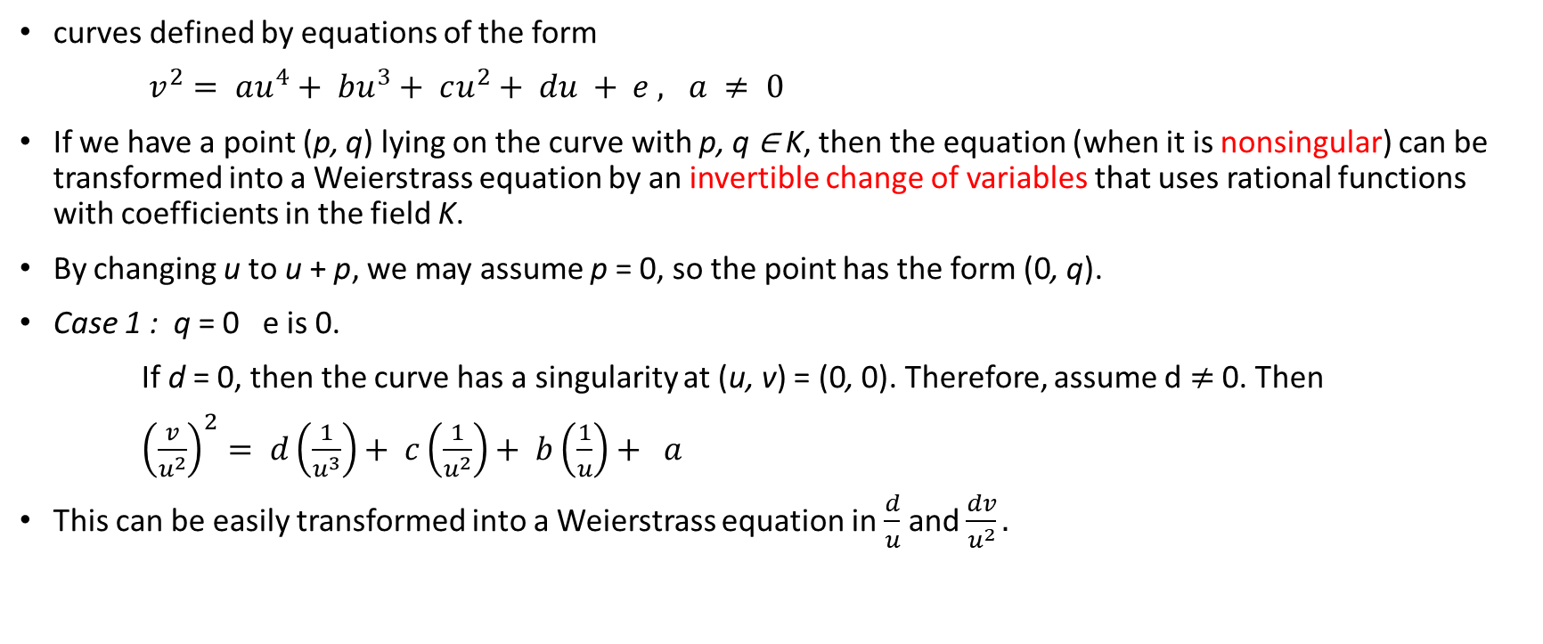
Quartic Equations
curves defined by equations of the form
$v^{2}= au^{4}+ bu^{3}+ cu^{2}+ du + e , a ≠ 0$
If we have a point (p, q) lying on the curve with p, q ∈ K, then the equation (when it is nonsingular) can be transformed into a Weierstrass equation by an invertible change of variables that uses rational functions with coefficients in the field K.
By changing u to u + p, we may assume p = 0, so the point has the form (0, q).
Case 1 : q = 0 e is 0.
If d = 0, then the curve has a singularity at (u, v) = (0, 0). Therefore, assume d $≠$ 0. Then
${\left(\frac{v}{u^{2}}\right)}^{2}= d\left(\frac{1}{u^{3}}\right)+ c\left(\frac{1}{u^{2}}\right)+ b\left(\frac{1}{u}\right)+ a$
This can be easily transformed into a Weierstrass equation in $\frac{d}{u}$ and $\frac{dv}{u^{2}}.$

Slide 6

Case 2 : $q ≠ 0$ e is $q^{2}$
Consider $x =\frac{2q\left(v + q\right)+ du}{u^{2}}$ $y=\frac{4q^{2}\left(v + q\right)+ 2q\left(du + cu^{2}\right)−\left(\frac{d^{2}u^{2}}{2q}\right)}{u^{3}}$ and
$a_{1}=\frac{d}{q} , a_{2}= c − \left(\frac{d^{2}}{4q^{2}}\right), a_{3}= 2qb, a_{4}= −4q^{2}a, a_{6}= a_{2}a_{4}.$
From above substitutions we get
$y^{2}+ a_{1}xy + a_{3}y = x^{3}+ a_{2}x^{2}+ a_{4}x + a_{6}.$
The inverse transformation is
$u = \frac{2q\left(x + c\right)− \left(\frac{d^{2}}{2q}\right)}{y}$ and $v =\frac{−q + u\left(ux − d\right)}{2q}$
The point $\left(u, v\right)= \left(0, q\right)$ corresponds to the point $(x, y) = ∞$and $\left(u, v\right)= \left(0,−q\right)$corresponds to $\left(x, y\right)= \left(−a_{2}, a_{1}a_{2}− a_{3}\right).$

Slide 7
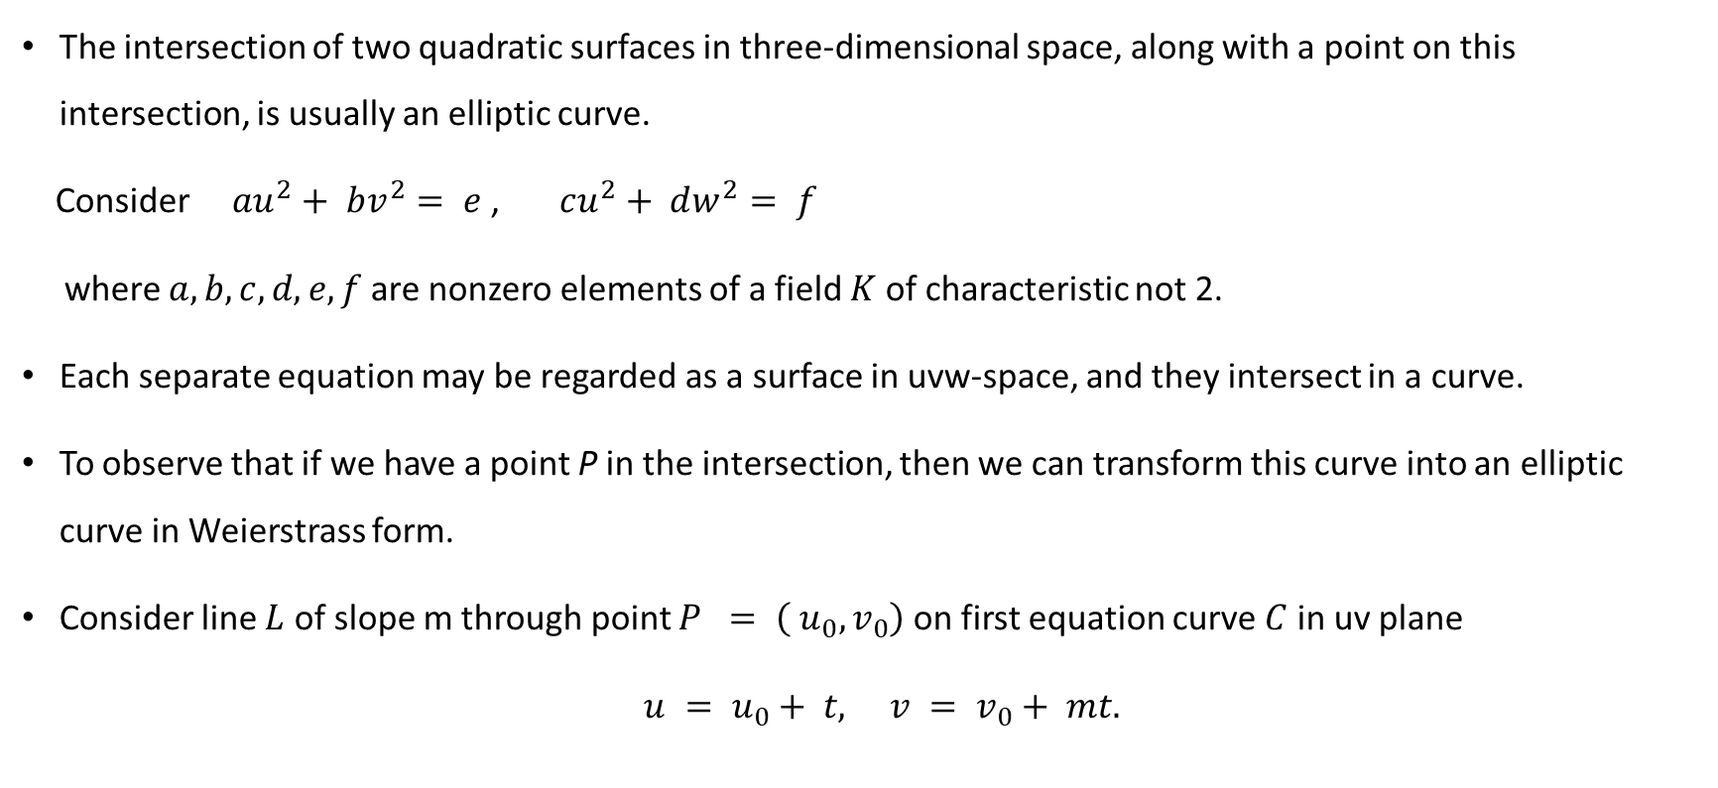
Intersection of two quadratic surfaces
The intersection of two quadratic surfaces in three-dimensional space, along with a point on this intersection, is usually an elliptic curve.
Consider $au^{2}+ bv^{2}= e$, $cu^{2}+ dw^{2}= f$
where $a, b, c, d, e, f$are nonzero elements of a field $K$ of characteristic not 2.
Each separate equation may be regarded as a surface in uvw-space, and they intersect in a curve.
To observe that if we have a point P in the intersection, then we can transform this curve into an elliptic curve in Weierstrass form.
Consider line $L$ of slope m through point $P = \left( u_{0}, v_{0}\right)$ on first equation curve $C$ in uv plane
$u = u_{0}+ t, v = v_{0}+ mt.$

Slide 8
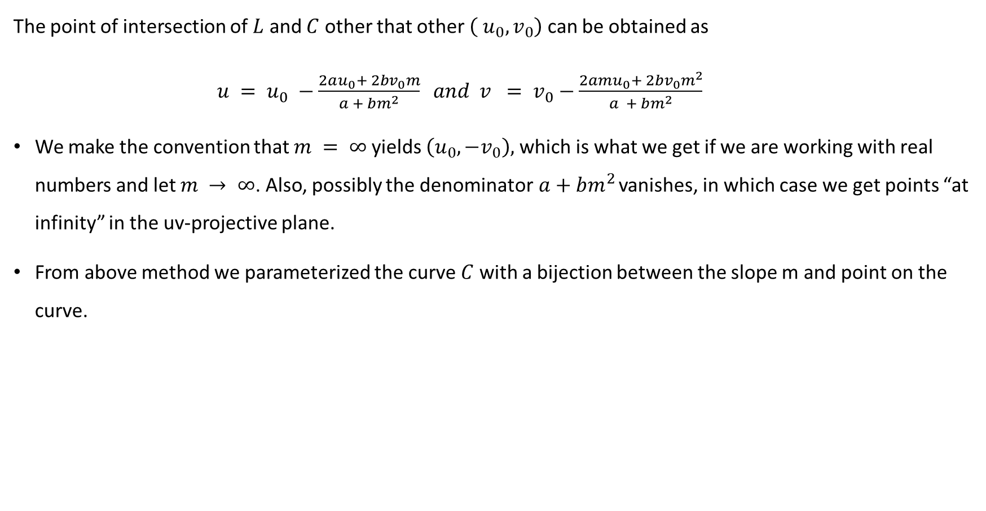
The point of intersection of $L$ and $C$ other that other $\left( u_{0}, v_{0}\right)$ can be obtained as
$u = u_{0} −\frac{2au_{0}+ 2bv_{0}m}{a + bm^{2}} and v = v_{0}−\frac{2amu_{0}+ 2bv_{0}m^{2}}{a + bm^{2}}$
We make the convention that $m = ∞$yields $\left(u_{0},−v_{0}\right),$which is what we get if we are working with real numbers and let $m → ∞$. Also, possibly the denominator$a+bm^{2}$ vanishes, in which case we get points “at infinity” in the uv-projective plane.
From above method we parameterized the curve $C$ with a bijection between the slope m and point on the curve.

Slide 9
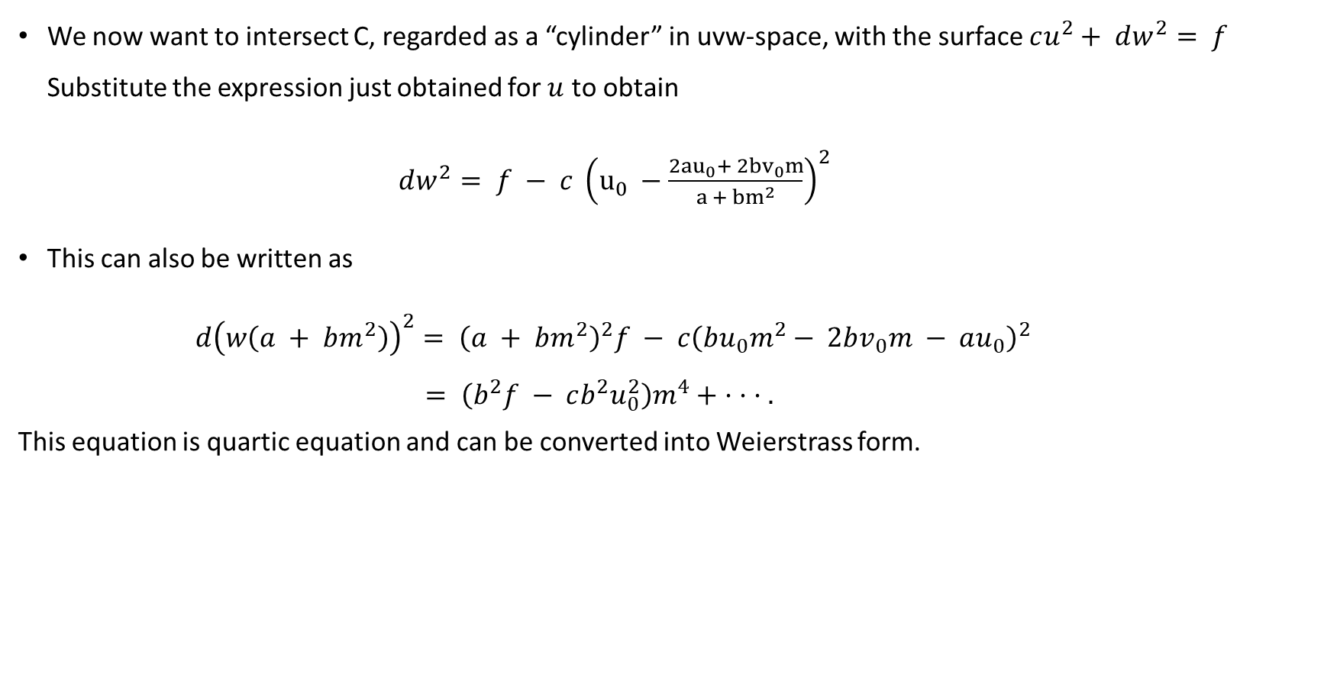
We now want to intersect C, regarded as a “cylinder” in uvw-space, with the surface $cu^{2}+ dw^{2}= f$ Substitute the expression just obtained for $u$ to obtain
$dw^{2}= f − c {\left(u_{0} −\frac{2{au}_{0}+ 2{bv}_{0}m}{a + {bm}^{2}}\right)}^{2}$
This can also be written as
$d{\left(w\left(a + bm^{2}\right)\right)}^{2}= {\left(a + bm^{2}\right)}^{2}f − c{\left(bu_{0}m^{2}− 2bv_{0}m − au_{0}\right)}^{2}$
$= \left(b^{2}f − cb^{2}u_{0}^{2}\right)m^{4}+ · · · .$
This equation is quartic equation and can be converted into Weierstrass form.

Slide 10
j - invariant

Slide 11
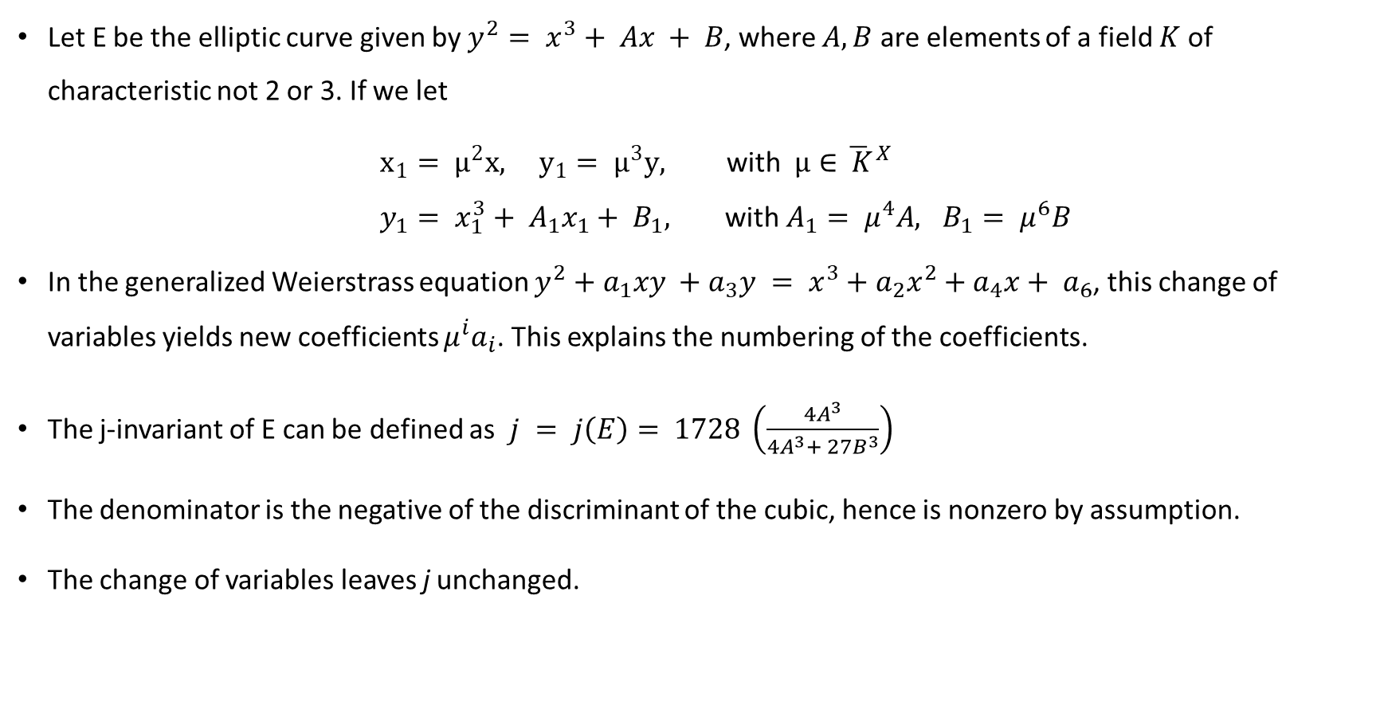
Let E be the elliptic curve given by $y^{2}= x^{3}+ Ax + B$, where $A,B$ are elements of a field $K$ of characteristic not 2 or 3. If we let
$x_{1}= μ^{2}x, y_{1}= μ^{3}y,$ with $μ∈{\overline{ K}}^{X}$
$y_{1}= x_{1}^{3}+ A_{1}x_{1}+ B_{1},$ with $A_{1}= μ^{4}A, B_{1}= μ^{6}B$
In the generalized Weierstrass equation $y^{2}+a_{1}xy +a_{3}y = x^{3}+a_{2}x^{2}+a_{4}x+ a_{6}$, this change of variables yields new coefficients $μ^{i}a_{i}$. This explains the numbering of the coefficients.
The j-invariant of E can be defined as $j = j\left(E\right)= 1728 \left(\frac{4A^{3}}{4A^{3}+ 27B^{3}}\right)$
The denominator is the negative of the discriminant of the cubic, hence is nonzero by assumption.
The change of variables leaves j unchanged.

Slide 12
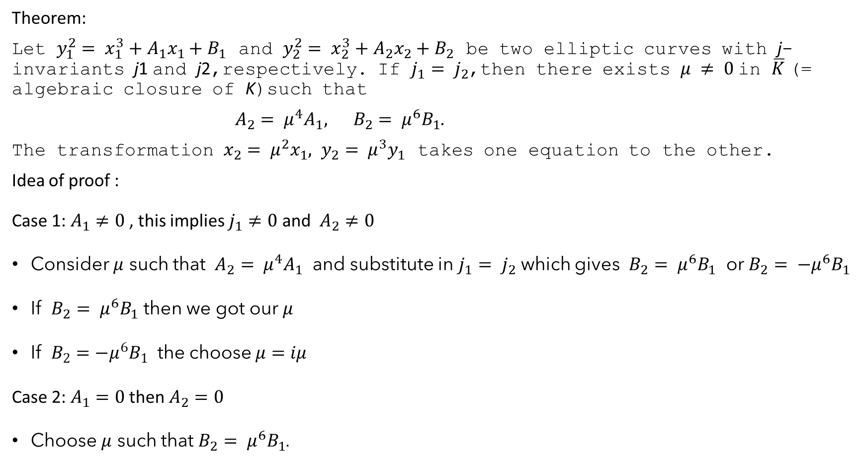
Theorem:
Let $y_{1}^{2}= x_{1}^{3}+A_{1}x_{1}+B_{1}$ and $y_{2}^{2}= x_{2}^{3}+A_{2}x_{2}+B_{2}$ be two elliptic curves with j-invariants j1 and j2,respectively. If $j_{1}= j_{2}$,then there exists $μ ≠ 0$in $\overline{K}$ (= algebraic closure of K)such that
$A_{2}= μ^{4}A_{1}, B_{2}= μ^{6}B_{1}$.
The transformation $x_{2}= μ^{2}x_{1}, y_{2}= μ^{3}y_{1}$ takes one equation to the other.
Idea of proof :
Case 1: $A_{1}≠0$ , this implies $j_{1}≠0$ and $A_{2}≠0$
Consider $μ$ such that $A_{2}= μ^{4}A_{1}$ and substitute in $j_{1}= j_{2}$ which gives $B_{2}= μ^{6}B_{1}$ or $B_{2}= {−μ}^{6}B_{1}$
If $B_{2}= μ^{6}B_{1}$ then we got our $μ$
If $B_{2}=−μ^{6}B_{1}$ the choose $μ=iμ$
Case 2: $A_{1}=0$ then $A_{2}=0$
Choose $μ$ such that $B_{2}= μ^{6}B_{1}$.

Slide 13
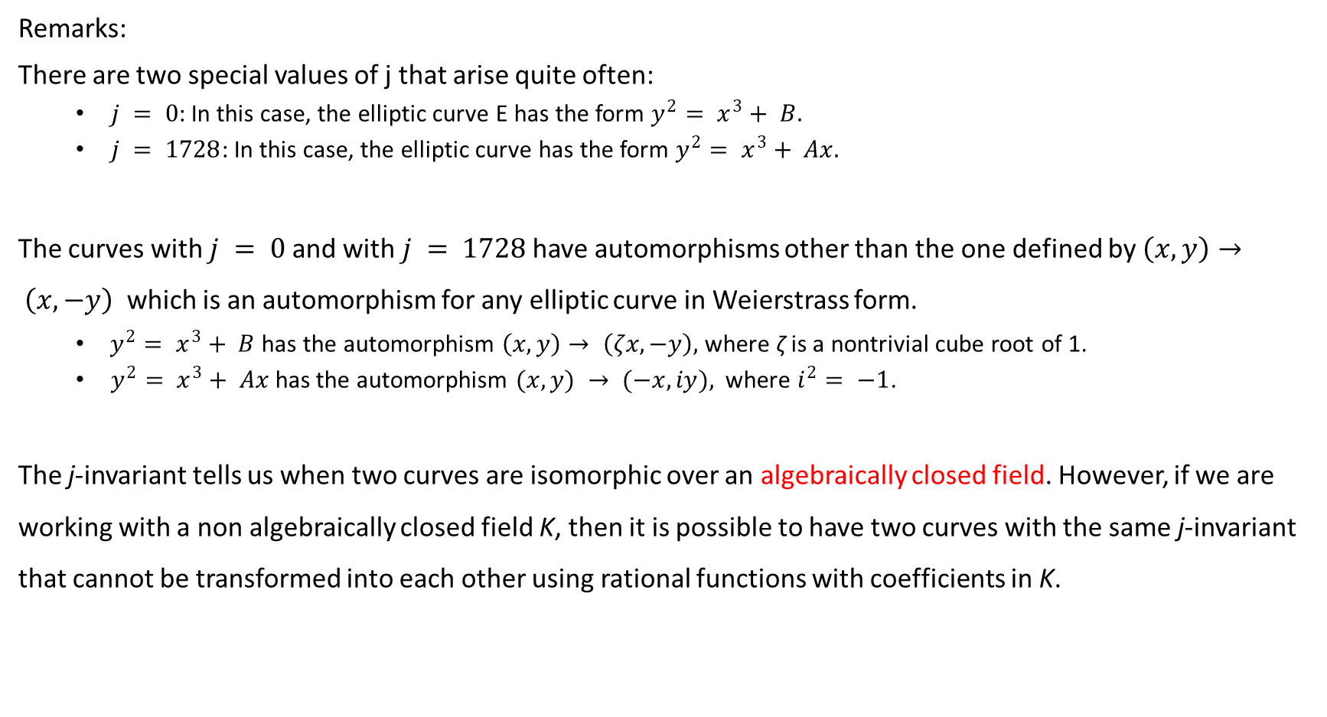
Remarks:
There are two special values of j that arise quite often:
$j = 0$: In this case, the elliptic curve E has the form $y^{2}= x^{3}+ B.$
$j = 1728$: In this case, the elliptic curve has the form $y^{2}= x^{3}+ Ax.$
The curves with $j = 0$and with $j = 1728$have automorphisms other than the one defined by $\left(x, y\right)→ \left(x,−y\right)$ which is an automorphism for any elliptic curve in Weierstrass form.
$y^{2}= x^{3}+ B$has the automorphism $\left(x, y\right)→ \left(ζx,−y\right),$where ζ is a nontrivial cube root of 1.
$y^{2}= x^{3}+ Ax$has the automorphism $(x, y) → (−x, iy),$ where $i^{2}= −1$.
The j-invariant tells us when two curves are isomorphic over an algebraically closed field. However, if we are working with a non algebraically closed field K, then it is possible to have two curves with the same j-invariant that cannot be transformed into each other using rational functions with coefficients in K.

Slide 14

If two different elliptic curves defined over a field K have the same j-invariant, then we say that the two curves are twists of each other.
Each j ∈ K corresponds to an elliptic curve defined over K, and any two elliptic curves defined over K and with the same j-invariant can be transformed into each other by a change of variables defined over $\overline{K}$

Slide 15
Elliptic Curves in Characteristic 2

Slide 16
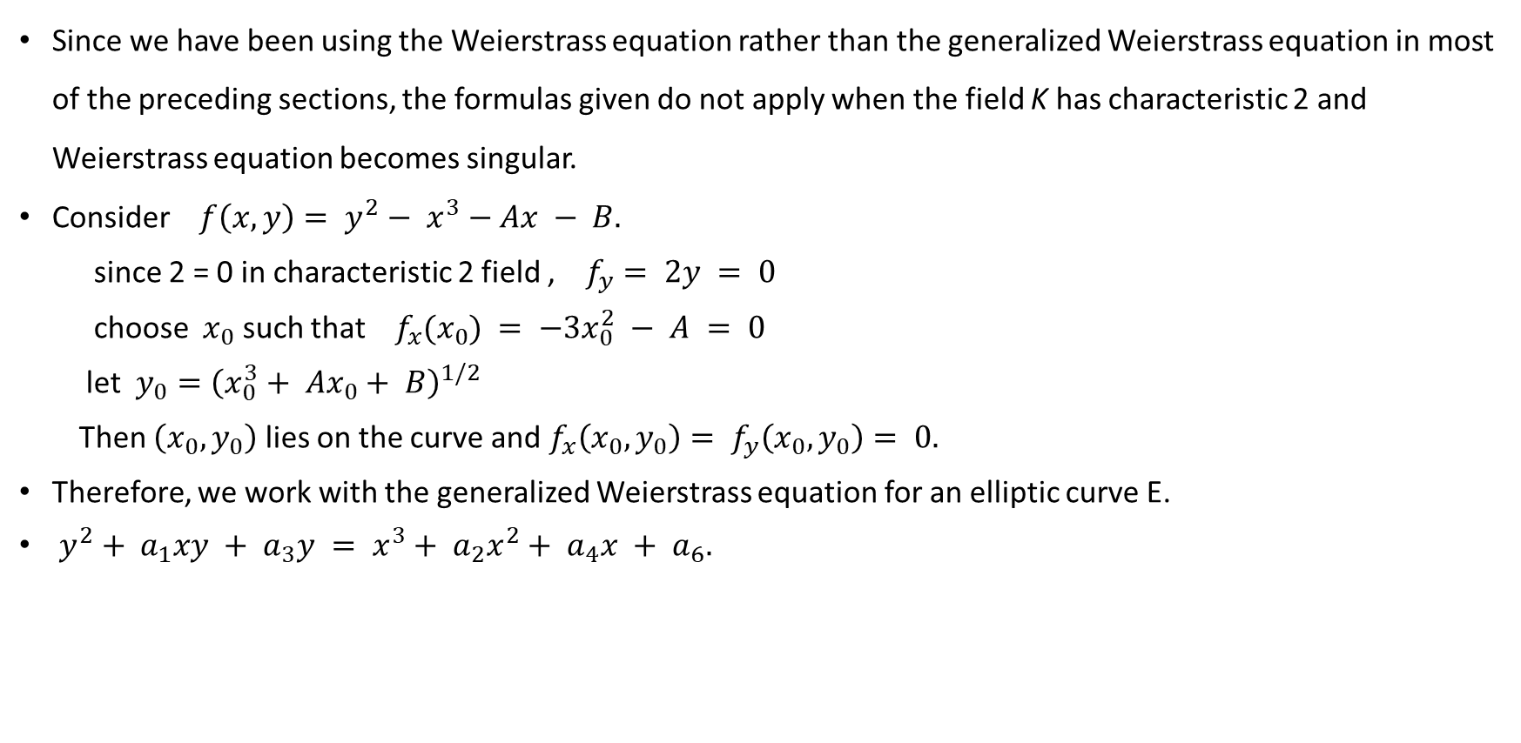
Since we have been using the Weierstrass equation rather than the generalized Weierstrass equation in most of the preceding sections, the formulas given do not apply when the field K has characteristic 2 and Weierstrass equation becomes singular.
Consider $f\left(x, y\right)= y^{2}− x^{3}−Ax − B.$
since 2 = 0 in characteristic 2 field , $f_{y}= 2y = 0$
choose $x_{0}$ such that $f_{x}(x_{0}) = −3x_{0}^{2} − A = 0$
let $y_{0}={\left(x_{0}^{3}+ Ax_{0}+ B\right)}^{1/2}$
Then $\left(x_{0}, y_{0}\right)$ lies on the curve and $f_{x}\left(x_{0}, y_{0}\right)= f_{y}\left(x_{0}, y_{0}\right)= 0.$
Therefore, we work with the generalized Weierstrass equation for an elliptic curve E.
$y^{2}+ a_{1}xy + a_{3}y = x^{3}+ a_{2}x^{2}+ a_{4}x + a_{6}.$

